Slide 1
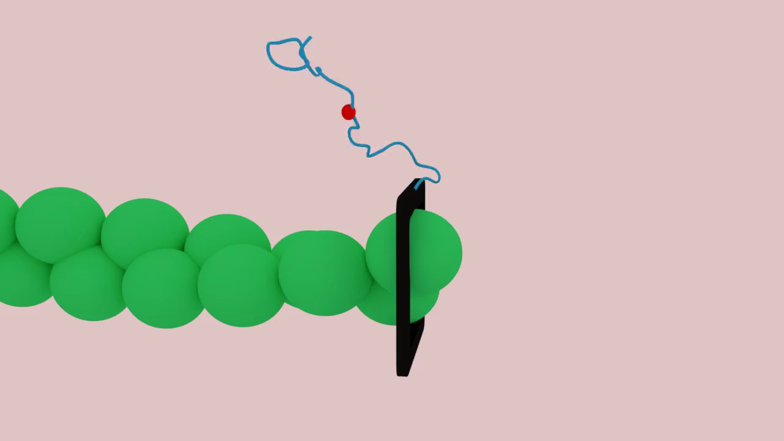
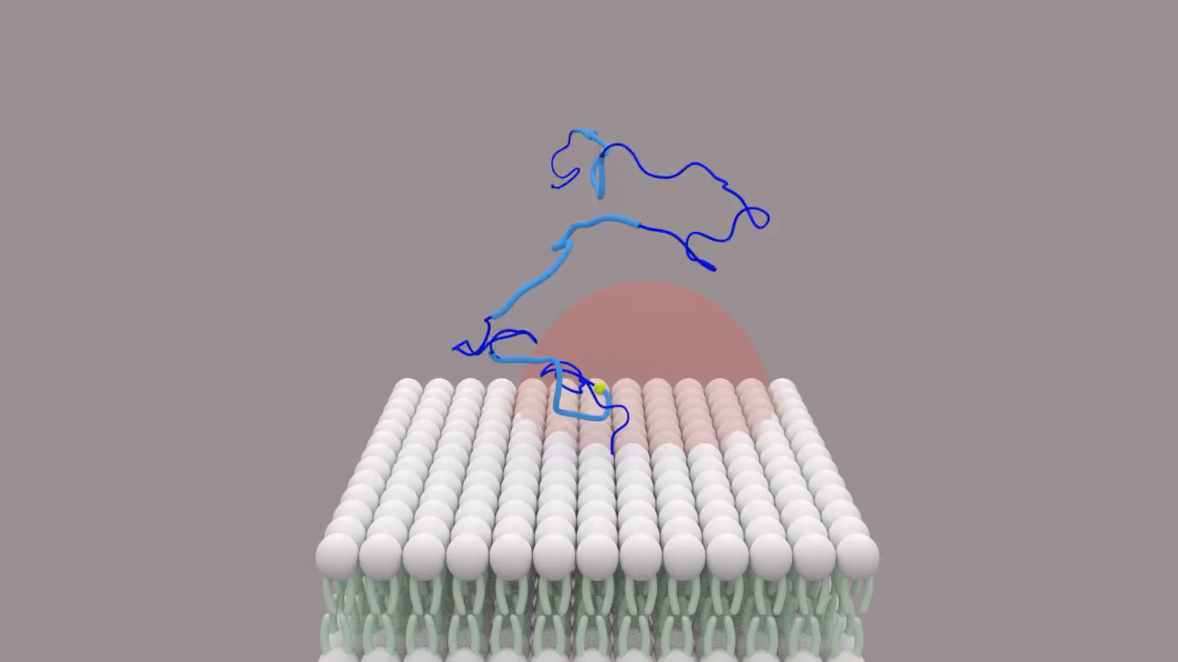
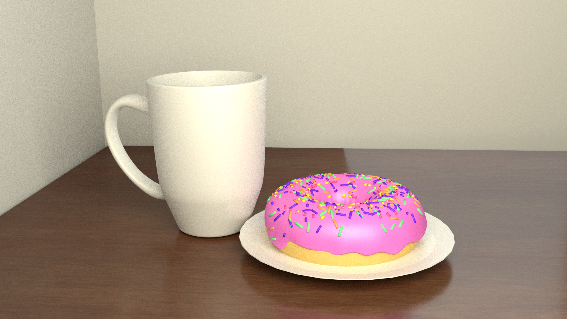
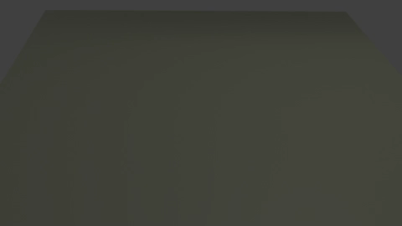
Blender tutorial
Abdon Iniguez

Slide 2
Blender Examples
Alzheimer's disease
Open source library
http://www.bioblender.org/
Blender Movie
https://staff.aist.go.jp/yutaka.ueno/blend/

Slide 3
Outline
Basic Navigation
Object mode
Edit Mode
Materials
Modeling
Lighting
Rendering
Images
Animations
Python + Blender
bpy library
Formin Example
Notes:
You have a lot of freedom in what you want to do. My proposal would be something like:
10min on examples of people using Blender to do important scientific things, include some spectacular examples
10min lecture-style overview of the GUI, rendering, python integration
30min going through the tutorial you gave to Allard Lab back in summer of 2018, with students following along
30min on python+blender, with students following along. (They will have had a 90min intro to python, and indeed 11 out of 12 incoming students report knowing python already).
30min for a “project”, for example to make a movie of A) a DNA-binding protein like a methyltransferase moving along a piece of DNA, B) gastrulation, or C) a cartoon of the student’s most recent research project from undergrad.

Slide 4
Outline
Basic Navigation
Object mode
Edit Mode
Materials
Modeling
Lighting
Rendering
Images
Animations
Python + Blender
bpy library
ZetaChain

Slide 5
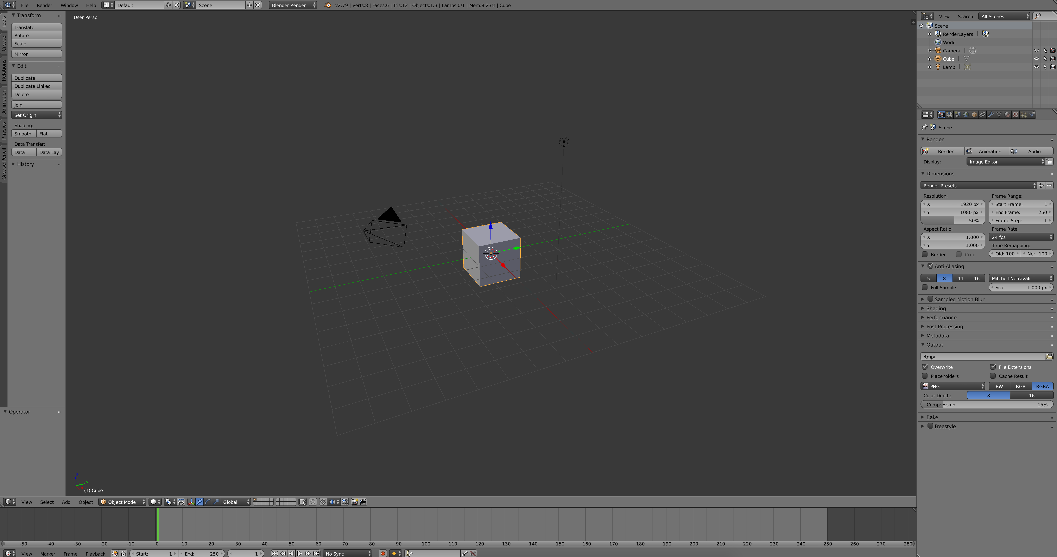
User Interface
3d Viewport
Properties Panel
Change object information
Left Panel
Create/edit objects
Animation Panel

Slide 6
Moving around
Moving around
Middle mouse button
Orbits
Hotkeys
Numberpad 7: Top
Numberpad 1: Front
Numberpad 3: Side
Focusing on other things (Moving around scene)
Shift + Middle Mouse Drag
Exercise: focus on Cube, Camera, and Light
Hot Keys
Numberpad 7: topview
Numberpad 1: Front
Numberpad 3-side

Slide 7
Outline
Basic Navigation
Object mode
Edit Mode
Materials
Modeling
Lighting
Rendering
Images
Animations
Python + Blender
bpy library
ZetaChain

Slide 8
Move, rotate, and scale Objects
Delete Object
X
Scaling: Click on object and push S
Shift: slows down the scaling
Control: Increments
Moving
3d Widget tool
G
X key, y key ,z key
Middle Mouse key
Hold and point in the direction you want to go
Rotate
R
X key, y key ,z key
Hot Keys
Numberpad 7: Top
Numberpad 1: Front
Numberpad 3: Side
X: Delete
Shift+a: Create Object
S: scaling feature
g: Moving object
Notes:
Add object: Point out options
Only edited when you first add

Slide 9
Subdivision modifier
Always create an object with low resolution
It becomes a problem later when rendering
use modifiers
Subdivision modifier
Hot Keys
Numberpad 7: Top
Numberpad 1: Front
Numberpad 3: Side
X: Delete
Shift+a: Create Object
S: scaling feature
g: Moving object
Notes:
Show the vertices in edit mode
Wave modifier

Slide 10
Outline
Basic Navigation
Object mode
Edit Mode
Materials
Lighting
Rendering
Images
Animations
Python + Blender
bpy library
ZetaChain

Slide 11
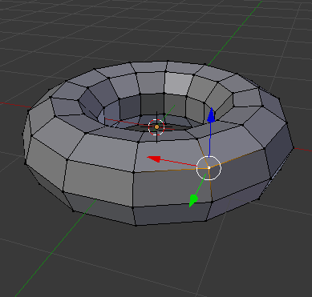
Edit Mode
Changes the shape of the object
Tab: edit mode
Widget
Selecting Vertices, edges, and Faces
Left Click
Box select
Circle select
Proportional control
O: proportional edit
Hot Keys:
In edit mode
Hot Keys
Numberpad 7: Top
Numberpad 1: Front
Numberpad 3: Side
X: Delete
Shift+a: Create Object
S: scaling feature
g: Moving object
Tab: Edit mode
O: proportional edit
b: Box Select:
c: Circle Select
Shift: Choose multiple
Alt+left mouse click:
Choose entire row/column
Notes:
When you enter edit mode, we only look at specific object
Vertices:
Edge:
Face:
Shift: Choose more than one
Alt + Left Mouse click: Choose entire row or column
O :proportional vertex edit

Slide 12
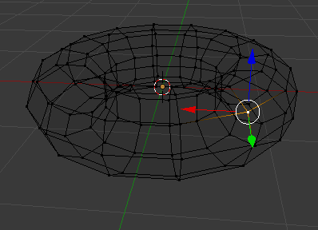
Wire Frame mode
Removes faces
z: wire frame mode
Hot Keys:
In edit mode
Hot Keys
Numberpad 7: Top
Numberpad 1: Front
Numberpad 3: Side
X: Delete
Shift+a: Create Object
S: scaling feature
g: Moving object
Tab: Edit mode
O: proportional edit
b: Box Select:
c: Circle Select
Shift: Choose multiple
Alt+left mouse click:
Choose entire row/column

Slide 13
Outline
Basic Navigation
Object mode
Edit Mode
Materials
Modeling
Lighting
Rendering
Images
Animations
Python + Blender
bpy library
ZetaChain

Slide 14
Materials
Material Node Editor
Render
We will be using Cycles Render
Some more shortcuts!
H: Hide
Alt+h: Bring back hidden objects
Hot Keys
Numberpad 7: Top
Numberpad 1: Front
Numberpad 3: Side
X: Delete
Shift+a: Create Object
S: scaling feature
g: Moving object
Tab: Edit mode
H: Hide
Alt+h: Bring back hidden objects
Hot Keys:
In edit mode
O: proportional edit
b: Box Select:
c: Circle Select
Shift: Choose multiple
Alt+left mouse click:
Choose entire row/column
Notes:
Rendering engine
Blender render: since 90s
No longer being developed
Cycles: 7-8 years ago

Slide 15
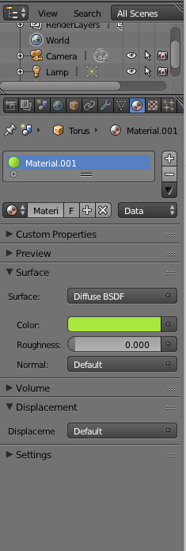
Changing Materials
To change materials of an object, click on the materials tab
The changes made are only seen in the final product
To quickly render and see the final product, use Shift+z or widget
Hot Keys
Numberpad 7: Top
Numberpad 1: Front
Numberpad 3: Side
X: Delete
Shift+a: Create Object
S: scaling feature
g: Moving object
Tab: Edit mode
H: Hide
Alt+h: Bring back hidden objects
Shift+z: Quick Render
T: toolbar
Hot Keys:
In edit mode
O: proportional edit
b: Box Select:
c: Circle Select
Shift: Choose multiple
Alt+left mouse click:
Choose entire row/column

Slide 16
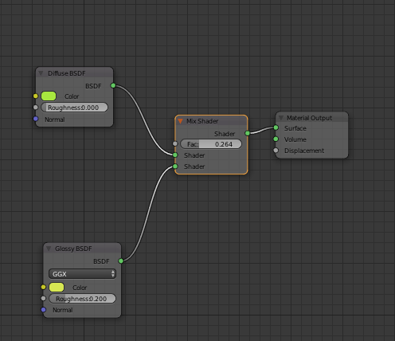
Node Editor
Used to create complex material
Hot Keys
Numberpad 7: Top
Numberpad 1: Front
Numberpad 3: Side
X: Delete
Shift+a: Create Object
S: scaling feature
g: Moving object
Tab: Edit mode
H: Hide
Alt+h: Bring back hidden objects
Shift+z: Quick Render
T: toolbar
Hot Keys:
In edit mode
O: proportional edit
b: Box Select:
c: Circle Select
Shift: Choose multiple
Alt+left mouse click:
Choose entire row/column

Slide 17
Nodes
Each node represents a feature to the material
Shift+a: adds new node
Note: You should only connect to the same color
Hot Keys
Numberpad 7: Top
Numberpad 1: Front
Numberpad 3: Side
X: Delete
Shift+a: Create Object
S: scaling feature
g: Moving object
Tab: Edit mode
H: Hide
Alt+h: Bring back hidden objects
Shift+z: Quick Render
T: toolbar
Hot Keys:
In edit mode
O: proportional edit
b: Box Select:
c: Circle Select
Shift: Choose multiple
Alt+left mouse click:
Choose entire row/column
Notes:
Show the example

Slide 18
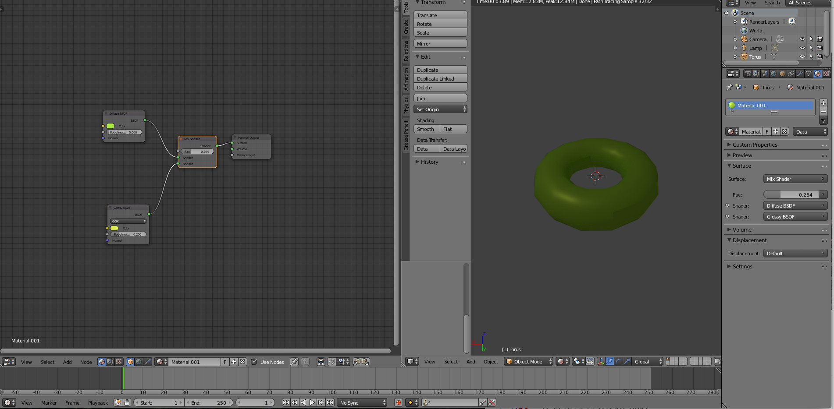
Split Screens
Splitting screens helps with node editing, editing objects, moving objects, etc
To split, at the top right of the viewport, there is a
Hot Keys
Numberpad 7: Top
Numberpad 1: Front
Numberpad 3: Side
X: Delete
Shift+a: Create Object
S: scaling feature
g: Moving object
Tab: Edit mode
H: Hide
Alt+h: Bring back hidden objects
Shift+z: Quick Render
T: toolbar
Hot Keys:
In edit mode
O: proportional edit
b: Box Select:
c: Circle Select
Shift: Choose multiple
Alt+left mouse click:
Choose entire row/column

Slide 19
Outline
Basic Navigation
Object mode
Edit Mode
Materials
Modeling
Lighting
Rendering
Images
Animations
Python + Blender
bpy library
ZetaChain

Slide 20
Modeling
Any objects we create (lipids), we will need to model with the given shapes
We will use a cup as an example of the three functions I use
We will use inset, extrude, and add loop to create a cup
i in edit mode: inset
E in edit mode: extrude
Ctrl+r in edit mode: Create loop
Hot Keys
Numberpad 7: Top
Numberpad 1: Front
Numberpad 3: Side
X: Delete
Shift+a: Create Object
S: scaling feature
g: Moving object
Tab: Edit mode
H: Hide
Alt+h: Bring back hidden objects
Shift+z: Quick Render
T: toolbar
Hot Keys:
In edit mode
O: proportional edit
Box Select: b
Circle Select: o
Shift: Choose multiple
Alt+left mouse click:
Choose entire row/column
Ctrl+R: create loop
i:inset
E: extrude

Slide 21
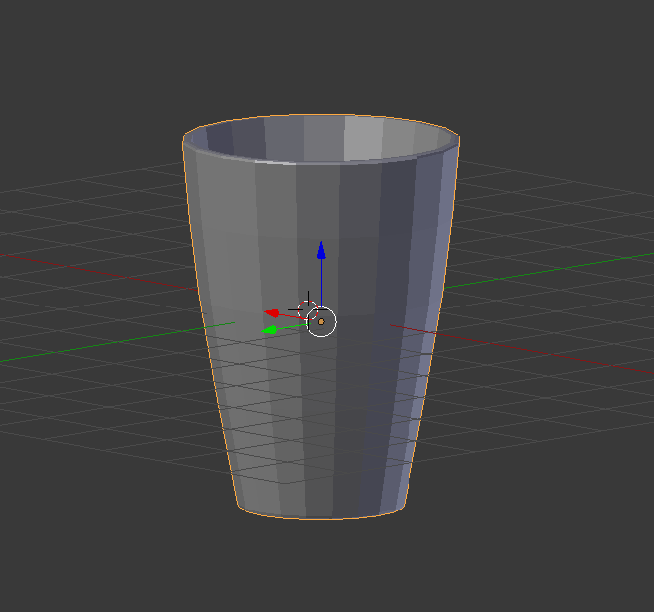
Creating a cup
Hot Keys
Numberpad 7: Top
Numberpad 1: Front
Numberpad 3: Side
X: Delete
Shift+a: Create Object
S: scaling feature
g: Moving object
Tab: Edit mode
H: Hide
Alt+h: Bring back hidden objects
Shift+z: Quick Render
T: toolbar
N: RHS panel
Hot Keys:
In edit mode
O: proportional edit
Box Select: b
Circle Select: o
Shift: Choose multiple
Alt+left mouse click:
Choose entire row/column
Ctrl+R: create loop
i:inset
E: extrude

Slide 22
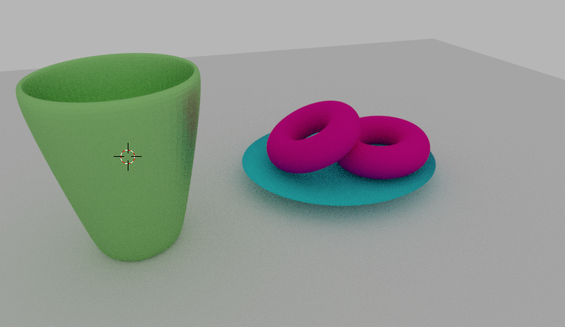
Exercise

Slide 23
Outline
Basic Navigation
Object mode
Edit Mode
Materials
Modeling
Lighting
Rendering
Images
Animations
Python
bpy library
ZetaChain

Slide 24
Lighting
Four types of lights
Point lamp
lighting in all directions
Sun
global
Only angle matters in the positioning
Different strengthi unit (<5)
Spot lamp
Limited area
Allows you to focus on certain objects
Hemi
Not supported by Cycles render
Area lamp:
Allows you to focus on certain things (similar to spot)
Hot Keys
Numberpad 7: Top
Numberpad 1: Front
Numberpad 3: Side
X: Delete
Shift+a: Create Object
S: scaling feature
g: Moving object
Tab: Edit mode
H: Hide
Alt+h: Bring back hidden objects
Shift+z: Quick Render
T: toolbar
N: RHS panel
Hot Keys:
In edit mode
O: proportional edit
Box Select: b
Circle Select: o
Shift: Choose multiple
Alt+left mouse click:
Choose entire row/column
Ctrl+R: create loop
i:inset
E: extrude
Notes:
Point lamp: Move cup
Sun: move lamp
angle lamp

Slide 25
World lighting
We can change the background color to a brighter to contribute to the lighting
Never use the world lighting as a primary light source
Washes out the scene
Hot Keys
Numberpad 7: Top
Numberpad 1: Front
Numberpad 3: Side
X: Delete
Shift+a: Create Object
S: scaling feature
g: Moving object
Tab: Edit mode
H: Hide
Alt+h: Bring back hidden objects
Shift+z: Quick Render
T: toolbar
N: RHS panel
Hot Keys:
In edit mode
O: proportional edit
Box Select: b
Circle Select: o
Shift: Choose multiple
Alt+left mouse click:
Choose entire row/column
Ctrl+R: create loop
i:inset
E: extrude
Note: Good lighting schemes have one key light source

Slide 26
Positioning the camera
Hot Keys
Numberpad 7: Top
Numberpad 1: Front
Numberpad 3: Side
X: Delete
Shift+a: Create Object
S: scaling feature
g: Moving object
Tab: Edit mode
H: Hide
Alt+h: Bring back hidden objects
Shift+z: Quick Render
T: toolbar
N: RHS panel
Cttrl+alt+np 0: moves camera to position you are looking at
R+middle mouse: Adjusting where the camera is
G+middle mouse: Zoom
We should always position the camera before the lighting
Move camera to position you are looking at
Ctrl+alt+numberpad 0
Adjusting where the camera is
r+middle mouse button
Hold down shift to slow down
Zoom in/out
G + middle mouse button
Hot Keys:
In edit mode
O: proportional edit
Box Select: b
Circle Select: o
Shift: Choose multiple
Alt+left mouse click:
Choose entire row/column
Ctrl+R: create loop
i:inset
E: extrude

Slide 27
Outline
Basic Navigation
Object mode
Edit Mode
Materials
Modeling
Lighting
Rendering
Images
Animations
Python
bpy library
ZetaChain

Slide 28
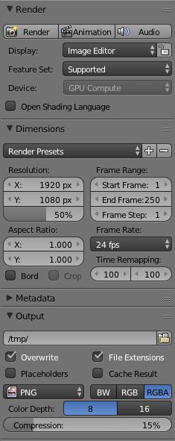
Rendering
Blender will automatically render with your CPU
Making the render faster
Tile Size
Reduce Samples
GPU
Rendering with GPU is much faster
To change: File>User Preferences>System
How to render?
Assuming your camera is in the right position, there three necessary components to change before you push render
Resolution (in Dimensions)
Where we want to output image (in Output)
What type of image (in output)
Number of Samples ( in sampling)
Tiles (in Performance)

Slide 29
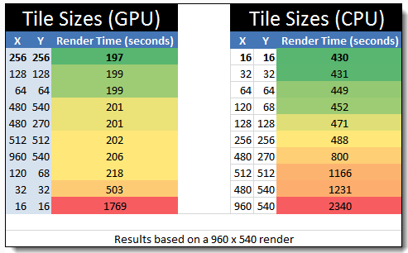
Tile Sizes
https://www.blenderguru.com/articles/4-easy-ways-to-speed-up-cycles

Slide 30
Creating a simple animation
Hot Keys
Numberpad 7: Top
Numberpad 1: Front
Numberpad 3: Side
X: Delete
Shift+a: Create Object
S: scaling feature
g: Moving object
Tab: Edit mode
H: Hide
Alt+h: Bring back hidden objects
Shift+z: Quick Render
T: toolbar
N: RHS panel
Cttrl+alt+np 0: moves camera to position you are looking at
R+middle mouse: Adjusting where the camera is
G+middle mouse: Zoom
Alt+a: play
Ctrl+p:follow path
Let’s say we want our camera to follow a path to create an animation
Step 1:Create a circle (curve)
Step 2: Have the camera follow the curve
Click on the camera first and then the curve
Ctrl + p > Follow path
Step 3: Click on the curve
> path animation to control speed
Step 4: Play animation
Alt+a
Hot Keys:
In edit mode
O: proportional edit
Box Select: b
Circle Select: o
Shift: Choose multiple
Alt+left mouse click:
Choose entire row/column
Ctrl+R: create loop
i:inset
E: extrude

Slide 31
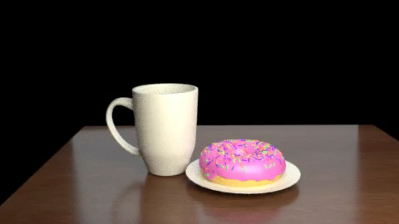
Rendering Animation
Rendering animation is very similar to rendering an image
Two differences
Output>ffmpeg_video
Encoding>Presents changes to Encodin>h264 in mp4

Slide 32
Outline
Basic Navigation
Object mode
Edit Mode
Materials
Modeling
Lighting
Rendering
Images
Animations
Python + Blender
bpy library
Formin

Slide 33
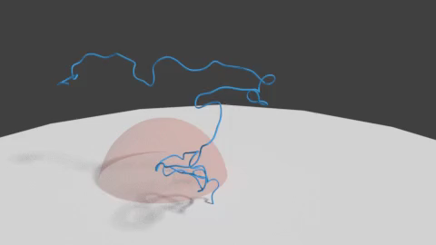
A little closer to home

Slide 34
Thanks for listening!

